Slide 1
Building Hybrid Cloud

Slide 2
Objectives
After completing this course, you will be able to:
Understand the common modes of hybrid cloud
Understand the common use cases of hybrid cloud
Master the architecture planning of hybrid cloud
Master the selection of Tencent Cloud private cloud services
Understand how to select a cloud management platform (CMP)
Notes:
培训对象：云架构师，参加此培训需要先学习腾讯云架构TCA课程。

Slide 3
Section 1. Overview of Hybrid Cloud
Section 2. Architecture Design of Hybrid Cloud
CONTENTS
Section 3. Hybrid Cloud Management
Section 4. Tencent Hybrid Cloud Practices

Slide 4
Section 1. Overview of Hybrid Cloud
1.1 Concepts of hybrid cloud
CONTENTS
1.2 Reasons why enterprises should use hybrid cloud
1.3 Use cases of hybrid cloud
Notes:
Hybrid Cloud and key scenarios

Slide 5
1.1 Concepts of hybrid cloud
- Gartner
Notes:
Cloud computing has been evolving.
Definition: A hybrid IT environment allows traditional on-site data center infrastructure to live side-by-side with cloud environments (public cloud, private cloud)
Many companies still operate and manage services in on-site data centers due to issues such as:
Security
Compliance
Interdependencies with legacy systems
Cost of migration
The hybrid cloud refers to a mixed computing, storage, and services environment made up of on-premises infrastructure, private cloud services, and a public cloud—with orchestration among the various platforms.
(END)

Slide 6
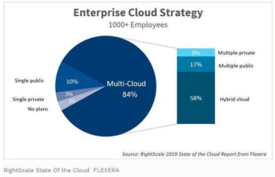
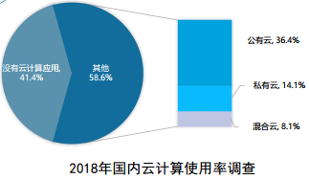
1.1 Concepts of hybrid cloud (continued)
Globally, hybrid cloud has become the main form of enterprise cloud services. According to RightScale's report on cloud usage status in 2019, 84% of surveyed enterprises adopted a multi-cloud strategy. Among them, the proportion of enterprises using hybrid cloud continuously increased from 51% in 2018 to 58% in 2019.
In China, still only a minority of enterprises are using hybrid cloud. According to the survey conducted by China Academy of Information and Communications Technology, in 2018, the proportion of Chinese enterprises using cloud computing was close to 60%, of which 14% were using hybrid cloud, a slight increase from 2017.
Notes:
According to many surveys, the adoption of hybrid cloud in enterprises is increasing.
The RightScale's report on cloud usage status in 2019, 84% of surveyed enterprises adopted a multi-cloud strategy. Among them, the proportion of enterprises using hybrid cloud is more than half.
Source: "China Hybrid Cloud Development Survey Report", China Academy of Information and Communications Technology

Slide 7
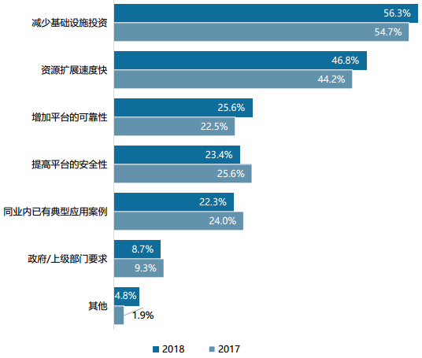
1.2 Reasons why enterprises should use hybrid cloud
Reduced investment in infrastructure and fast resource scaling are two major reasons why enterprises choose hybrid cloud
In addition, improved platform reliability and security and industry-specific success stories also explain why hybrid cloud is favored by enterprises
China Hybrid Cloud Development Survey Report
Notes:
Why enterprises choose hybrid cloud? The 2 major reasons are Reduced investment in infrastructure and fast resource scaling
Source: "China Hybrid Cloud Development Survey Report", China Academy of Information and Communications Technology

Slide 8
1.3 Common use cases of hybrid cloud
Disaster recovery, data backup, and load scaling are three key use cases of hybrid cloud.
China Hybrid Cloud Development Survey Report
Notes:
The 3 key business cases of hybrid cloud are Disaster Recovery, Data Backup, and Load Scaling

Slide 9
1.3 Common use cases of hybrid cloud (continued)
Load scaling
Public cloud can be used during peak hours for elastic scaling
Disaster recovery
Local storage and public cloud form a primary/secondary architecture together
Data backup
Local data is encrypted and backed up in the public cloud
Application deployment
Different applications are deployed in different clouds
Development, testing, production, and deployment
Development and testing can be quickly iterated locally, while the production businesses run in the public cloud
Notes:
Apart from the 3 use cases, businesses also use hybrid cloud for deployments of different applications and deployment of different env. Let’s look into all these different use cases. [NEXT]

Slide 10
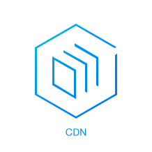
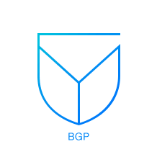
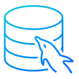
1.3.1 Load Scaling
The private cloud handles regular traffic, while the public cloud sustains peak access traffic
Regular traffic
Traffic surge
Private cloud
Public cloud
Direct Connect
CLB
Subnet 1
Server
VPN
Subnet 2
VPC 1
Database
Notes:
In this scenario, application serving is in the private cloud. When traffic suddenly increases, instead of adding more capacity, the hybrid cloud model is utilized to account for temporary capacity expansion. For example, at the end of the quarter, the corporate financial system might need to calculate and generate a large number of reports. At this time, we can temporarily rent the public cloud to make up for the lack of computing resources.

Slide 11
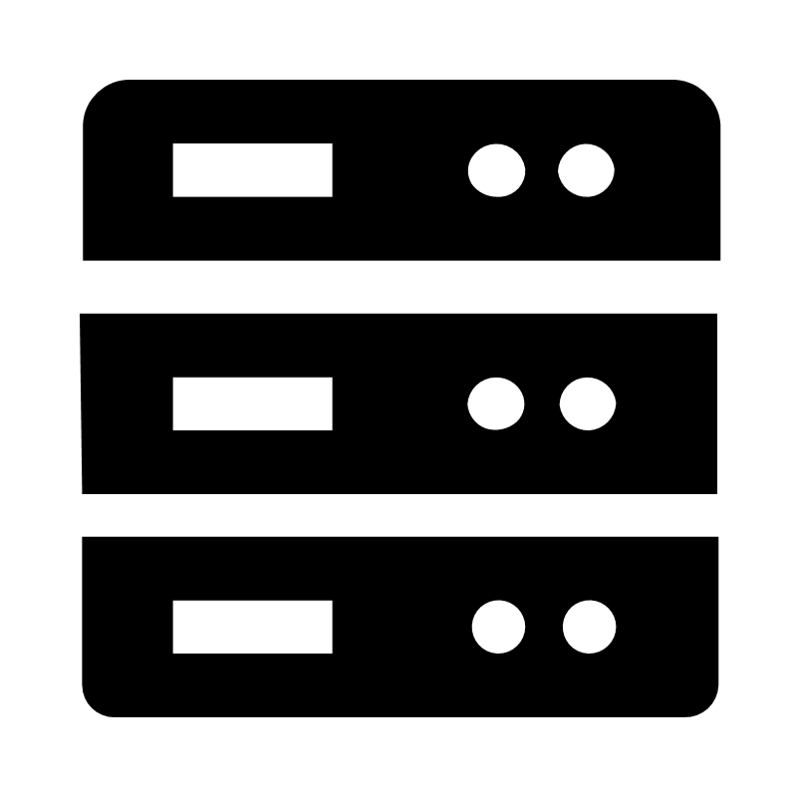
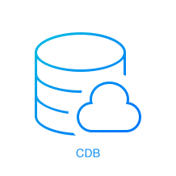
1.3.2 Disaster Recovery
The private cloud stores the business data, while the public cloud stores the backup data
In/Off-cloud primary/secondary architecture
Public cloud
Private cloud
Web layer
Keepalive
Web layer
Application layer
Application layer
Database layer
Database layer
Notes:
Disaster recovery of hybrid cloud generally adopts a master-slave architecture.
Under this architecture, users can put the backup of business system on the public cloud, and make use of the technical advantages, operation and maintenance management of the public cloud provider to achieve Data Disaster Recovery and ensure service continuity. In the event of a major disaster in a private cloud data center, users can use the system hosted in the public cloud to bring up the backup system

Slide 12
1.3.3 Data Backup
Data in the private and public clouds is mutually backed up on the other side
The storage advantages of the public cloud are leveraged
Backup data is archived after being encrypted
The purpose of data backup is to keep the data or application at a certain time point in a safe and reliable place. In general scenarios, application load runs in the public or private cloud, while the data is backed up in another cloud for security and stability
Notes:
The purpose of data backup is to store data or applications at a certain time in a safe and reliable place.
So we use either private/public cloud to serve the application, and the data backup is placed in another cloud for security and stability reason.

Slide 13
1.3.4 Application Deployment
Applications are deployed in the private and public clouds accordingly
abc.com
Public cloud
Private cloud
CDN
CLB
Frontend
Backend
AS
Notes:
For enterprises with multiple branches, if the business is handled centrally at HQ, when the volume increases, the processing capacity and access bandwidth will become the bottleneck. Through the hybrid cloud solution, the front-end service is deployed on the public cloud, taking advantages of the public cloud with multiple regions and CDNs to make the service as close to the end user as possible, and the back-end system is still deployed in the private cloud at the headquarters. Only a small amount of front-end and back-end interaction are required to complete the entire business process. Hybrid cloud solution can provide a cross-cloud network channel, connecting the environment on the public cloud and the private network.

Slide 14
1.3.5 Development, Testing vs Production Deployment
Applications can be developed and tested in the public cloud, but deployed and released in the private cloud
Public cloud: in-cloud development
Private cloud: local deployment
Web layer
Web layer
Application layer
Application layer
Database layer
Database layer
Notes:
In this scenario, the different stages of the same application are independent of each other, and there is no direct connection.
And those are the common scenarios for adopting hybrid cloud. [END]

Slide 15
Section 2. Architecture Design of Hybrid Cloud
2.1 Challenges to hybrid cloud architecture
2.2 Network architecture design of hybrid cloud
CONTENTS
2.3 Storage design of hybrid cloud
2.4 Application architecture design of hybrid cloud
2.5 Selection of Tencent Cloud private cloud services
Notes:
[Skip]

Slide 16
2.1 Challenges to hybrid cloud architecture
A hybrid cloud environment is complex. How do we implement fast and reliable network connection between the public cloud, private cloud, and IDC?
Private and public clouds should play their roles in active/active disaster recovery and make full use of their respective strengths. How do we arrange the workload, design the storage, and exchange data between in/off-cloud environments?
IT environments are scattered, and each has its own account system. How do we implement efficient OPS?
Network interconnection
Storage interconnection
Account interconnection
Notes:
Now that we understand the main application scenarios of hybrid cloud, what are the things that need to be considered when creating a hybrid cloud architecture?
In the next section, we will look at how to design a hybrid cloud architecture from 3 aspects: Network architecture, Storage architecture, and Workload Planning. Also, we will look at the choice of Tencent’s Private Cloud products.
Account connection: Use a set of accounts to manage public and private clouds. Binding the public cloud access key to the corresponding account of the private cloud, and combining the respective permission systems of the private cloud and the public cloud, can achieve extremely flexible multi-tenant scenarios and establish an account management system that meets the requirements of the enterprise. Generally realized through cloud management platform

Slide 17
2.2 Network architecture design of hybrid cloud
2.2.1 Network architecture design of hybrid cloud
2.2.2 Network connections in multi-branch organizations
2.2.3 Interconnection within multi-cloud network
Notes:
First, the network...

Slide 18
2.2.1 Network architecture design of hybrid cloud
Are there any other problems?
Interconnect IDCs and public clouds
Interconnect multiple public clouds
The network is planned globally to avoid subnet conflicts
Traffic
Latency
Private cloud
Public cloud
Direct Connect
Considerations
CLB
Subnet 1
Subnet 1
Security and encryption
Peering Connection
Server
VPN
Subnet 2
Subnet 2
High Availability
VPC 1
VPC 2
Database
Notes:
The main goal of hybrid cloud network is connect and allow communication between different clouds through a secure and encrypted network connection. Therefore, the network is the first thing to consider and is the foundation of hybrid cloud.
The most common architecture is to use dedicated lines or IPSec VPNs to connect private with public cloud data centers.
VPN is recommended in the early stage of cloud migration, such as the test stage, to quickly forming the hybrid cloud. A dedicated line will be used at later stage to ensure the stable operations after production go-live.
And whether it is a dedicated line or a VPN, multiple branches can be connected to a public cloud data center at the same time. Many companies build a network architecture centered on public cloud data centers in the later stage of cloud migration to ensure the stability and user experience of branch offices accessing cloud application systems.
One major networking design consideration, in the hybrid cloud network, is that there can be no conflicting subnets, and the subnet segment needs to be planned before building the Hybrid Cloud Network.

Slide 19
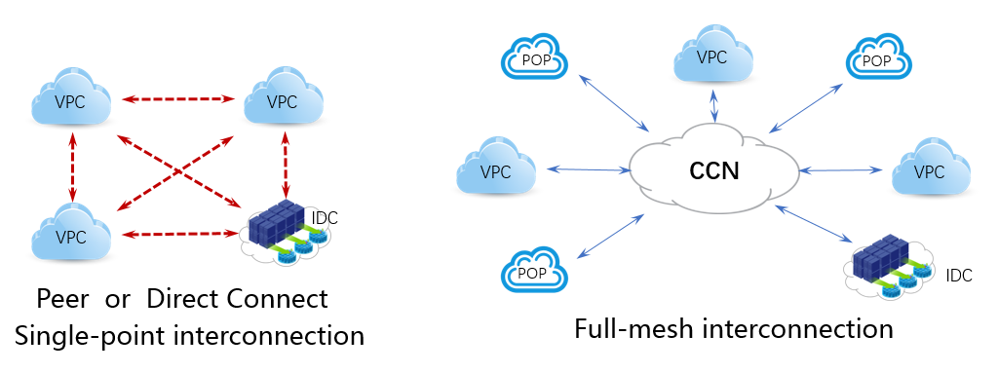
2.2.2 Network connections in multi-branch organizations
Large enterprises usually have many branches, which leads to complex networking schemes and complicated network management. How do we solve these problems?
Cloud Connect Network (CCN) provides global interconnection between in-cloud VPCs and between VPCs and enterprise data centers. VPCs and Direct Connect gateway instances can be added to CCN to implement global interconnection.
Item | Peering Connection/Direct Connect | CCN
Connectivity | Single-Point interconnection | Global interconnection after one configuration for nearby access
IP range overlap | VPC IP ranges can not overlap | VPC IP ranges can overlap, while subnets do not overlap
Configuration | Manual configuration management | Smart learning and scheduling and automated route distribution
Notes:
However, for large organizations with multiple branches, there will be multiple public cloud VPCs and multiple cross-regional branches that need to be interconnected, the private lines or VPN will no longer work. Solution: we need to combine private lines and CCN.
CCN is a service of Tencent Cloud. It uses dedicated lines between multiple data centers to help build private network communication channels between public cloud VPCs, and between VPCs and local IDCs, which allows for cross-regional communication.
CCN has automatic routing and learning capabilities, that simplifies the management
Multiple local IDCs are interconnected through public cloud VPC and CCN, such as Guangzhou local IDC->Guangzhou public cloud VPC->CCN->Hong Kong public cloud VPC->Hong Kong local IDC
Typical application scenarios are global access acceleration, multi-regional disaster tolerance architecture, etc.
To ensure that network instances in CCN are interconnected, CCN restricts the CIDR blocks of the network instances.
Note on Limits on VPC CIDR blocks
CCN restricts CIDR blocks at the subnet level: Even though the CIDR blocks of two VPCs overlap, as long as their subnets have different CIDR blocks, you can still add them to CCN for interconnection. Only two subnets with identical CIDR blocks in different VPCs cannot interconnect.
2 Rules for CIDR Overlapping Conflict
If CIDR blocks overlapped, the route of the 1st network associated with the CCN will take effect.
For a network already in CCN, if the route conflict occurs, i.e., new subnet created, the new route will not take effect, and the existing valid route will remain valid.
Rules for CIDR inclusive conflict
If the CIDR blocks of multiple network instances have an inclusive conflict, only the route of the network instance that is first associated with the CCN instance will take effect

Slide 20
Notes:
Is invalid. But you can enable the route in the routing table, and after enabling it, the data will be forwarded with the longest mask matching rule。
包含冲突示例
VPC1 先与云联网实例 A 关联，其子网的 CIDR 为 10.0.1.0/20，与云联网内其他实例可以互通。此时 VPC2 再与云联网实例 A 关联，其子网的 CIDR 为 10.0.1.0/24（包含在 VPC1 中子网的 CIDR 中），则由于产生 CIDR 包含冲突，VPC 2该子网的路由策略状态默认为无效，暂时不能与云联网内其他实例互通。
您可以在子网 B 的路由表中启用该路由，启用后将会以最长掩码匹配规则转发数据。当路由策略目的端为 10.0.1.0/24 时，根据规则，将会转发到 VPC2 的子网 B 中。
Difference from peer-to-peer connection/dedicated line channel
Before using Tencent Cloud to connect to the Internet, if you want to achieve the interoperability of multiple VPCs, IDCs and multiple VPCs, you need to establish a peer-to-peer connection between the VPCs, and establish a dedicated line channel for the IDC to each VPC, and each VPC and IDC None of the network segments can overlap, otherwise the connection cannot be established. After the connection is established, you also need to manage the routing table of each instance, and you can implement intercommunication after manually adding routing policies。
If you use Tencent Cloud Cloud networking in the above scenarios, you only need to create a CCN instance, and add the VPC and IDC that need to be interconnected to the cloud networking, and then all VPCs, IDCs and multiple VPCs can be interconnected. The routing of CCN is automatically forwarded and learned, so that you only need one operation to add instances to the cloud networking, no need to manually configure and manage the routing of each instance。

Slide 21
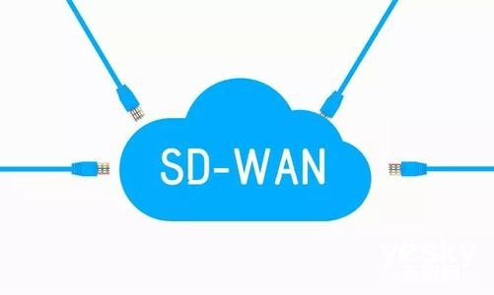
2.2.3 Interconnection within multi-cloud network
Use of multiple public cloud environments causes complex networks, VPN latency, inability to guarantee the stability, and high leased line costs. How do we design a more effective hybrid cloud network architecture?
SD-WAN
Software-defined wide area network (SD-WAN) combines multiple WAN linkages into one logical linkage, so as to interconnect network resources and schedule them in a unified manner.
Network performance can be improved by setting traffic throttling and linkage optimization with no need to make changes to the original network architecture.
Notes:
In the hybrid cloud architecture, the performance of the physical dedicated line is the best, because VPN connection delay and stability are difficult to guarantee.
But problem is that the dedicated line is expensive and might not be reachable in some places. In this circumstance, SD-WAN is used in place of private lines with various less-expensive WAN links, such as MPLS VPN. Enterprises still use private lines for service quality assurance for key data transmission, some relatively unimportant traffic will be dynamically migrated to public broadband networks, or even wireless On the LTE network.
SD-WAN (software-defined wide area network) is the application of software-defined network (SDN) to wide area networks, aiming to help users reduce (WAN) expenses and improve network connection flexibility. SD-WAN can realize multiple functions such as enterprise multi-branch and data center interconnection, link optimization, and hybrid cloud.
SD-WAN combines multiple physical WAN links into a logical network, defines different resources in the entire network space, sets traffic priorities, and creates, manages them in a programmable way
Manufacturers such as Cisco, Huawei, Qingyun, and Sangfor have all launched their own SD-WAN solutions. Basic operators, cloud service providers such as Tencent Cloud and Alibaba Cloud have introduced SD-WAN networking technology to optimize their private networks.

Slide 22
2.3 Storage design of hybrid cloud
2.3.1 Storage design of hybrid cloud
2.3.2 CSG
2.3.3 Database sync
Notes:
And, the second is Storage

Slide 23
2.3.1 Storage design of hybrid cloud
What should we pay attention to when designing a storage architecture for enterprises that use hybrid cloud?
Different storage features
Different storage protocols
Different storage costs
Real-Time disaster recovery
Public cloud storage is elastically scalable, while private cloud storage is more controllable for enterprises. How do we arrange storage for different data types?
Local storage devices may use different storage protocols and standards. How do we implement data communication between them and public clouds?
No matter whether a public or private cloud is used, the storage costs vary by performance. How do we maximize the cost effectiveness?
A common scenario of hybrid cloud is to use the public cloud as a disaster recovery environment. How do we implement real-time sync?
Notes:
Hybrid cloud storage is the combination of private cloud storage and public cloud storage, so that the two can be combined to provide storage services.

Slide 24
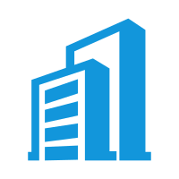
2.3.1 Storage design of hybrid cloud (continued)
Hot data
Cold data
Enterprise data
Comprehensive considerations
Performance
Security
Costs
Scalability
Storage classification
Primary storage
Secondary storage
Archive storage
Multiple storage tools are used across clouds to build storage systems at different prices and performance levels
Notes:
Given the characteristics of hybrid cloud, storage can be tiered. The first tier is the main storage system, which is usually the highest performing. The first layer is also the closest to application and the most expensive. The second layer, also called secondary storage, tends to have lower performance and cheaper prices. It is intended as an active backup system for the primary storage layer, or as a system for storing old or infrequently accessed data deleted from the primary storage. Finally, the archive storage layer is the cheapest, but also the slowest system, used to store rarely used data.
From the performance perspective: the main storage of active data is generally private cloud storage, and the archived data is stored in archive storage, which is generally public cloud storage.
From security and regulations perspective: Because the software and hardware resources of the private cloud are self-owned and exclusive, storing important and sensitive data in the private cloud storage allows higher Controllability and safety;
From scalability perspective: With the (virtually) unlimited capacity of public cloud storage, the overall hybrid cloud storage also has the feature of unlimited capacity;
From a cost perspective: You can choose to store some archived data, rarely accessed data, and data with low access performance requirements in public cloud storage. You can also use COS for data lifecycle management on Tencent Cloud to further separate cold and hot data.

Slide 25
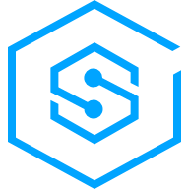
2.3.2 CSG
Protocol conversion
Accelerated access
Snapshot and data backup
Network resource adjustment
Snapshot
Image
Backup
Volume gateway
Gateway types
File gateway
Tape gateway
Notes:
The cloud storage gateway uses Object storage as back-end storage, while providing industry-standard file services (NFS and SMB) and block storage services (iSCSI) for cloud and off-cloud applications
The CSG is a software that can be deployed on the public cloud or on the local IDC
Using CSG, the application can connect to COS through standard NFS, SMB, iSCSI, etc., and not have to modify the file access method
Common scenarios include: data backup and archiving, storage expansion, separation of hot and cold data, etc.
Local disks can be used as local caching of hot data (to accelerate hot data access)
Gateway type
Volume gateway: After deploying the volume gateway in the customer's local network environment or public cloud environment, COS can be mounted on the local application server as an Internet Small Computer System Interface (iSCSI) device. The volume gateway not only maintains low latency for hot data access, but also saves users a lot of primary data storage costs while minimizing the need for local storage expansion.
File gateway: COS can be used as a network file system (NFS) for multiple servers to mount. The file gateway eliminates the need for users to install the file system by themselves. Users can use the POSIX file protocol to read and write objects on COS.
Tape gateway: CAS (archive storage) can be used as a more economical and durable storage to store backup and archive data. The tape gateway provides a virtual tape infrastructure (VTL), which can be seamlessly expanded in the local network environment, and can eliminate the cost of expansion and operation and maintenance of the physical tape library

Slide 26
Notes:
Storage gateway function
Protocol conversion: support the public cloud storage of RESTful API as iSCSI storage, NFS/SMB/CIFS file storage or virtual tape library storage (VTL) directly mounted to the local network, ready to use. For enterprises that have deployed infrastructure, access to the public cloud no longer needs to change the existing network structure, and does not need to develop an interface to align network programs. The cloud storage gateway CSG can be used to access the public cloud and enjoy the low cost of mass cloud storage. Price and flexibility.
Accelerated access: The storage gateway stores frequently accessed hot data to local storage through a cache optimization algorithm, while colder data is automatically transmitted to cloud storage. Compared to directly connecting to the public cloud, you can get frequently used data more quickly. At the same time, by using cloud elastic storage, only the storage space required for fast-access caching is provided locally, which more effectively saves the cost of infrastructure and operation and maintenance.
Snapshots and data recovery: You can perform snapshots on a regular basis to back up the storage contents of the changing volume to the cloud data center. If there is an accident in the enterprise's local storage or historical data needs to be restored, you can restore the volume that can be mounted to the gateway or cloud server from the snapshot at any time to restore the data at the specified time.
Network resource adjustment: The storage gateway CSG compresses local data before uploading it to the cloud to optimize transmission efficiency; it also supports the configuration of uplink/downlink rate limits, which can more rationally use enterprise export bandwidth resources and save data transmission costs.

Slide 27
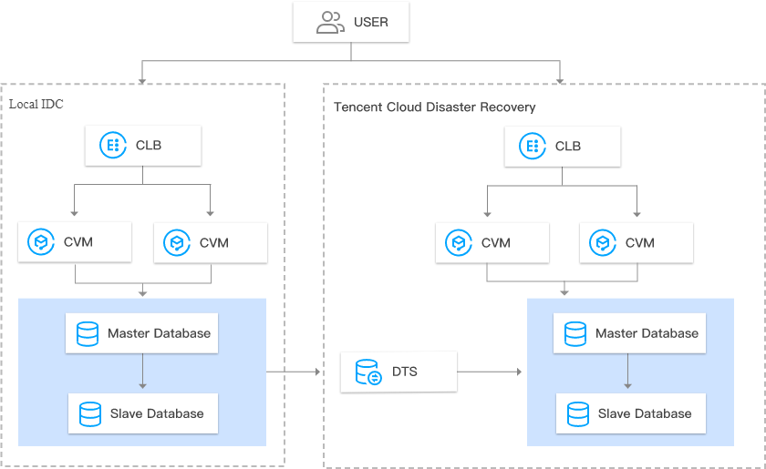
2.3.3 Database Sync
How do we sync databases in real time to implement disaster recovery?
DTS
Notes:
Tencent Cloud DTS can work through VPN, dedicated line of local IDC, and can be used in hybrid cloud environment for real-time data synchronization.
The data synchronization feature of DTS currently supports MySQL and targets to TencentDB for MySQL.

Slide 28
2.4 Application architecture design of hybrid cloud
Application architecture design of hybrid cloud
1
Workload planning of hybrid cloud
2
Application categorization
3
Application layer division

Slide 29
2.4.1 Workload planning of hybrid cloud
Considerations for workload arrangement
Business
Laws/Regulations
Business asset control
Business regions
Business continuity
Costs
Technology
SaaS
Team technology stack and backend integration
Data volume
Workload elasticity
Performance
Security

Slide 30
2.4.2 Application Categorization
Type | Features | Examples
Public cloud application | The application system has no special dependency on hardware; Nodes can be added to improve the processing capabilities of application servers; The application system can be effectively separated from data storage, and modular design is used with low requirements for real-time communication between modules. | Applications in development/testing environments, websites, training environments, demo portal environments, CRM, email system, etc.
Private cloud application | The system is proprietary; Data cannot be stored in the cloud according to laws and regulations; Data needs to be controlled as information assets | Banking applications.
Notes:
Under the hybrid cloud architecture, the application also has more scenarios and architecture choices to meet different availability levels, user experience, and security compliance requirements.
The conventional hybrid cloud application architecture is that applications with different requirements run in different cloud environments, for example:
For Internet applications, which require high concurrency and flexible expansion are deployed in the public cloud
Systems that contain sensitive data and have specific regulatory requirements, such as financial systems, are deployed in the local private cloud.
Systems with low latency and high IOPS requirements, such as file servers, mail servers, etc., are deployed in the local private cloud.
Some systems have no specific requirements, can be deployed on either public and private clouds.

Slide 31
2.4.3 Application Layer Division
Which layers should be put in the public cloud?
Is elastic scalability required?
Business regions
Which layers should be put in the private cloud?
Data security
Business asset control
Costs
Web layer
Application layer
Database layer
How do we divide the layers of an application for external users?
How do we divide the layers of an application for internal users?
How do we divide the layers of a data analysis application?
Notes:
Scenario 1: The application provides external services and needs to deal with burst traffic
Workload planning: Put the web layer on the public cloud. Use load balancing to distribute traffic, elastic scaling, and improve access performance through CDN。
Scenario 2: Having global business, non-core business software in branches, and strict control of web access permissions
Workload planning: Put the application layer and database into the public cloud, and put the web layer locally
Scenario 3: The big data processing platform requires a large number of back-end processing nodes
Workload planning: Put the application layer and database into the public cloud, and put the web layer locally
Scenario 4: The application processing has the customer's core technology, and the database has core secrets
Workload planning: Put the web layer in the public cloud, and put the application and database locally

Slide 32
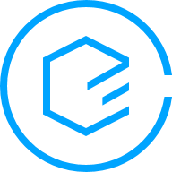
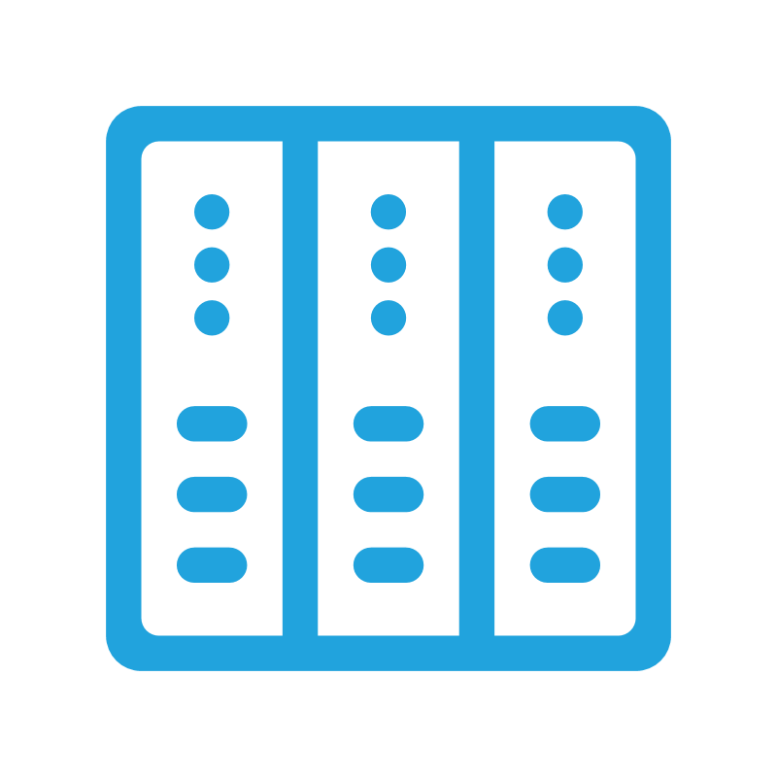
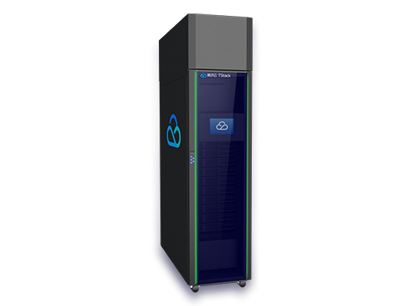
2.5 Selection of Tencent Cloud - Private Cloud solutions
Physical resource
Tencent Cloud
CPM-based TStack deployment
CPM cluster
VPC-based TStack deployment
Tencent Cloud
Technical resource
Developed by customer
Network: VPN, Direct Connect, and CCN
Storage: CSG
Database: DTS
Local TCE deployment
Integrated cabinet-based TStack delivery
Access to customer's own data center
Local TStack deployment
Owned by customer
Notes:
Tencent Cloud offers private cloud solutions: CPM, TCE, TStack
From the two dimensions of physical resources and technical resources, an Enterprise has options of building private clouds, the decision whether physical resources are owned by the enterprise or leased from Tencent Cloud, to build their own stack or use Tencent Cloud package offering
CPM: (Cloud Physical Machine, CPM 2.0) is a bare metal cloud service with a monthly subscription, providing a exclusive-performance and isolated physical server cluster to the company. Using this service, the number of physical servers can be flexibly scaled according to specific business requirements, and the time to obtain physical servers will be shortened to the minute. Hand over capacity management and operation and maintenance work to Tencent Cloud
TCE (based on Tencent Public cloud home-grown architecture): It is a full-stack cloud platform. It provides IaaS/PaaS/SaaS full cloud product matrix for the private deployment, independent and controllable needs of enterprises, providing customers with easy-to-operate, and intelligent cloud services
TStack (based on OpenStack and k8s): TStack is an enterprise-grade,full-stack, private cloud solution designed and refined by Tencent during the rapid development of its internet businesses. It is based on open source OpenStack and K8S, integrates with Tencent’s rich product system. TStack offers open standard APIs for multi-cloud and hybrid cloud management. It has been used/tested internally for over 8 years, hardware box + automated init script. Tencent is OpenStack Platinum Member [focus on government agencies]
TCE and TStack, the two models are developed simultaneously for the different needs of different customers.

Slide 33
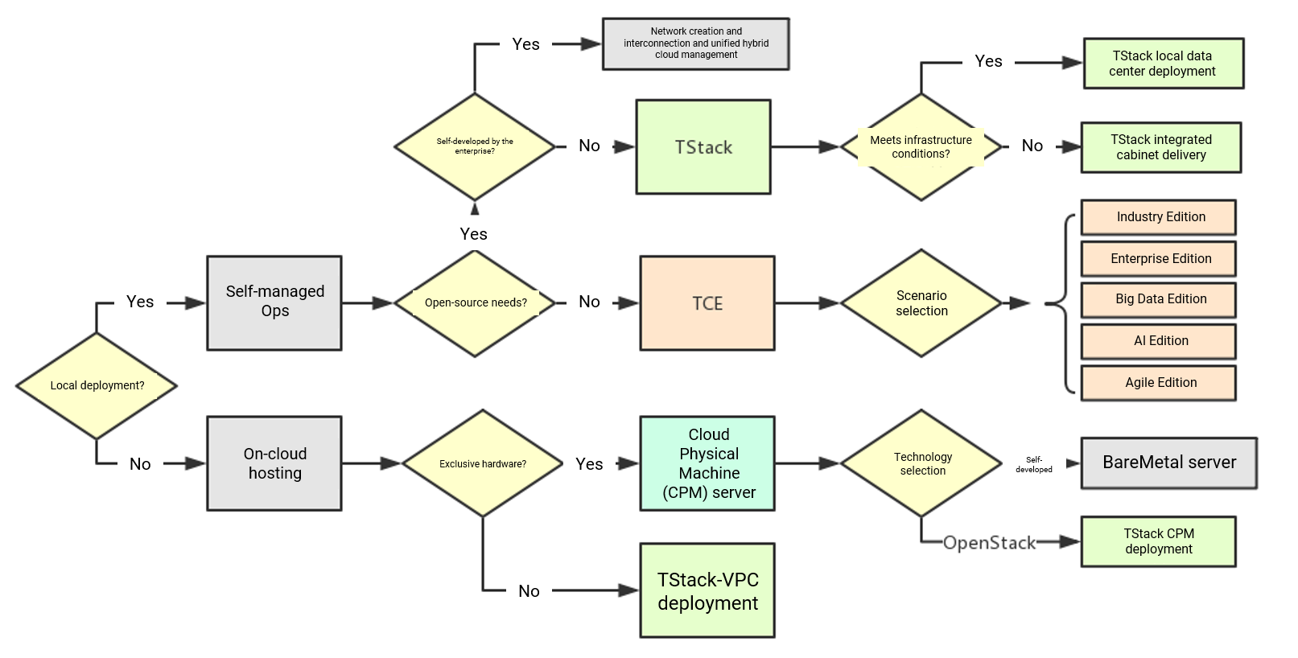
2.5.1 Private Cloud Scheme Selection
Notes:
Enterprises can develop private cloud platforms through open source technology, or use Tencent Cloud technology solutions for private cloud deployment

Slide 34
2.5.2 BM hybrid cloud architecture
Hybrid cloud architecture with a balance between elasticity and security
Physical resources are exclusive to ensure security in all aspects from server to network
It is inherently interconnected with public cloud to implement fast auto scaling
Dedicated solutions
Dedicated physical server leasing services
Dedicated database hosts
Special device hosting services
Physical cloud
Big data processing
Database
Special device hosting
Redis
Physical server
Virtual cloud
TencentDB for Redis
CDN
CVM
Network switch
CVM
CLB
Private cloud
Security service
Terminal service
Direct Connect VPN
Notes:
User scenario
Companies can create a private network on Tencent Cloud’s public cloud, that is, have their own high-performance physical machine. At the same time, because Blackstone’s private network and the internal network of Tencent Cloud’s public cloud can communicate with each other, the company can connect the core The architecture and data of ”are arbitrarily deployed between physical machines and virtual machines, and network bandwidth is completely free
Blackstone hybrid cloud services have the dual advantages of IDC hosting exclusive physical servers and cloud computing flexibility. Specifically, compared with IDC hosting, Blackstone retains the original architecture of the physical server on the one hand, and on the other hand can provide elastic scaling, More cloud computing services such as load balancing, private network, virtualized API, cloud security and operation and maintenance guarantee.
Tencent Cloud has launched private networks, custom servers, private clouds. These are the core services that hybrid cloud customers pay most attention to:
Blackstone private network: Different from the general logical isolation method on the host, Blackstone is a logically isolated network space realized by switch SDN technology. It is a more secure isolation mode, and it is highly flexible, scalable, and self-contained. Defined network capabilities, users can customize network segmentation, IP address and routing strategy;
Blackstone custom server: allows customers to define the server configuration according to their needs to meet individual needs. The scope of customization includes: CPU, memory, hard disk, GPU card, network card, etc.
Blackstone Private Cloud: Provides virtualization support, allowing customers to purchase Blackstone physical servers and build KVM and Docker virtualization platforms on top of them. At the same time, partners such as Tencent Cloud and Haiyun Jiexun have cooperated to form a private cloud solution based on Blackstone, which greatly shortens the delivery cycle of proprietary cloud projects in the industry. Customers only need to purchase Haiyun Jiexun’s proprietary cloud solution in the Tencent Cloud market, deploy in three steps and complete delivery within 2 to 3 days

Slide 35
2.5.3 TCE
Industry Edition
Enterprise Edition
Big Data Edition
AI Edition
Agile Edition
Full-Stack cloud platform established based on the complete service system of Tencent Cloud
Full cloud service matrix
Multi-Tenancy, flexible quotas, and metering and billing
Full-Stack cloud platform established based on the complete service system of Tencent Cloud
Full cloud service matrix
Single-Tenancy
One-Stop big data solution
Big data platform
Business analysis
Data visualization
Private AI solution
Image processing
Speech processing
Natural language processing
Container technology-based, DevOps-enabled, microservice application-oriented new-generation PaaS cloud platform
Spring Cloud-based deeply optimized distributed service framework
TDSQL
Notes:
TCE is an enterprise-level cloud platform launched based on the mature product system of Tencent’s public cloud. It supports privatized output. It has the characteristics of high availability, unified management and control, and industry compliance. It mainly provides professional and integrated private clouds for industry leaders and large group companies. solution。
For different usage scenarios, TCE has released the following versions
Industry version: A full-stack cloud platform based on the Tencent Cloud's complete product system. Provide IaaS/PaaS/SaaS full cloud product matrix, provide multi-tenant, quota, metering and billing capabilities, and operation and maintenance capabilities that support multi-tenancy
Enterprise Edition: TCE Enterprise Edition is a full-stack cloud platform based on the Tencent Cloud's complete product system. Provide IaaS/PaaS/SaaS full cloud product matrix for single tenant use.
Big data version: a one-stop big data solution, including big data platforms, business analysis, data visualization, supporting private deployment
AI version: A privatized artificial intelligence solution based on Tencent's ultra-large-scale machine learning platform and Youtu Lab's world-leading deep learning technology, covering applications in AI fields such as image, voice, and natural language, helping companies enhance their industry competitiveness.
Agile version: A new generation of PaaS cloud platform oriented to microservice applications based on container technology and DevOps as the concept. Provide a distributed service framework based on Spring Cloud's deep optimization and a distributed database TDSQL compatible with Mysql protocol to help customers quickly build a lightweight cloud platform.

Slide 36
2.5.4 TStack (https://intl.cloud.tencent.com/act/solution/tstack)
Local deployment
Integrated cabinet
Local data center
Deployment in customer's own IDC
Compatibility with mainstream virtualization technologies and hardware
No affect on the existing IT management process
Integrated cabinet
1. BM TStack integrated cabinet
2. Highly integrated portable cabinet
3. Highly integrated rack-based cabinet
4. Highly integrated water-cooled silent cabinet
BM-based (CPM) deployment
Tencent Cloud VPC
BM-based deployment
Dedicated BM service
On-demand purchase and pay-as-you-go billing
Data center OPS-free operations
Public cloud
Elastic scalability for reduced hardware costs
Access to public cloud
Lower operating costs
Notes:
From the current situation, TStack is mainly in the government and public organizations, because there are usually open source requirements in the governments.
TStack has 4 Deployment Modes：
Local Deployment - Deployed in customer’s own data center with their resources. It guarantees data security and works with popular virtualization platforms and hardware devices.
Integrated Cabinet - An integrated rack can be installed and deployed faster with both software and hardware bundled together, is ready-to-use when powered on. It can streamline hardware OPS.
Cloud Physical Machine - Because CPM is a pay-as-you-go, on-demand service. Customer will have access to security capabilities of Tencent public cloud platform and 24/7 professional OPS support.
Tencent Cloud VPC - VPC provides elastic scalability to reduce hardware costs. It can be connected to public clouds to further lower operating costs.
Integrated cabinet: standardized delivery form, strong versatility, adaptable to most scenarios, rapid deployment, efficient and convenient;
Localization: It can be deployed in the user's own data center with proprietary resources; it provides safe and reliable data protection, is compatible with mainstream virtualization and hardware, and does not affect the existing IT management process;
Blackstone: Buy on-demand, pay-as-you-go, enjoy the platform-level security capabilities of the public cloud, 7×24 hours of professional operation and maintenance support, and reduce operation and maintenance costs;
Tencent Cloud VPC: Flexible expansion, saving hardware costs, connecting with public cloud capabilities, and reducing operating costs
In actual deployment, when customers do not have the infrastructure conditions at all, such as city and county schools or hospitals and police stations, it is obviously unrealistic to build IDC from scratch. Users can directly purchase Tencent Cloud Blackstone TStack integrated cabinets.。

Slide 37
Section 3. Hybrid Cloud Management
Section 1. Evolution of Cloud Computing
3.1 Challenges to hybrid cloud management
CONTENTS
3.2 Core features of CMP
3.3 Overview of CMP
Notes:
The hybrid cloud is complex and includes different IT environments. How to manage the resources of different clouds is a key issue that enterprises using hybrid cloud need to consider.
This chapter introduces the functions of the CMP platform for hybrid cloud management, and analyzes the characteristics of the 3 cloud management platforms: Tstack, Awcloud, and EasyOps.

Slide 38
3.1 Challenges to hybrid cloud management
OPS complexity
Resource utilization
The resources of multiple cloud vendors, self-built private cloud platforms, and IDCs are managed at the same time, leading to a complicated environment that involves a large number of different technologies and bringing great challenges to OPS and management.
Resources are scattered and difficult to be scheduled in a unified manner. The resource utilization needs to be improved to optimize the costs.

Slide 39
3.1.1 Objects involved in hybrid cloud management
Cloud
management
layer
Integrated services that manage public, private, and hybrid cloud environments
Different roles for IT administrators, developers, testers, business personnel, IT decision makers, etc.
Cloud
architecture
layer
APIs provided for managing and delivering cloud resources
Private cloud: VMware (vCenter), OpenStack, System Center, etc.
Public cloud: Tencent Cloud and other cloud vendors
Container cloud: Docker and Kubernetes
Server, storage, virtualization, network infrastructure, etc.
Server virtualization: VMware (ESXi), KVM, Xen, and Hyper-V
Storage virtualization: VMware vSAN and EMC
Network virtualization: VMware NSX, Cisco, and Citrix
Resource
layer
Notes:
In order to better manage various resources, Gartner layered the cloud environment: cloud management layer, cloud architecture layer, and resource layer.

Slide 40
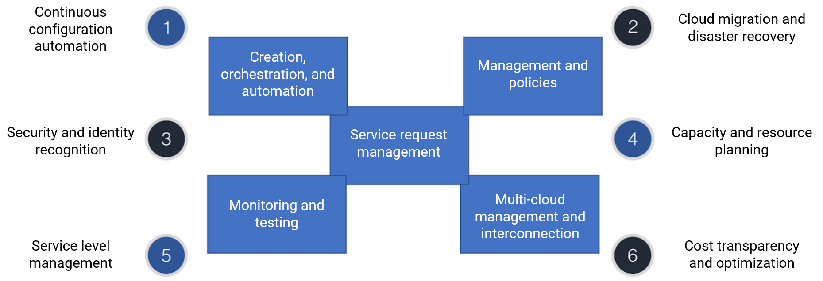
3.1 Solutions to challenges to hybrid cloud management
Select an appropriate CMP to implement all or part of the above features and solve the problems with hybrid cloud management
Notes:
Gartner proposed that hybrid cloud management needs to provide five core functional domains (ie the core requirements of hybrid cloud management):
Service request management;
multi-cloud management and connectivity;
management and strategy;
Provision, orchestration and automation;
Monitoring and measurement;
And six extended functions Domain:
Continuous configuration automation;
security and identification,
service level management,
cloud migration and disaster recovery,
capacity and resource planning,
cost transparency and optimization

Slide 41
3.2 Core features of CMP
Use CMP to meet the core needs for hybrid cloud management:
Notes:
At present, the common CMP (cloud management platform) on the market covers the five core functional areas of Gartner, but there are still considerable controversies in the six extended functional areas, especially cloud migration and disaster recovery and service level management, which are usually considered to be in the MSP. The scope of cloud service providers。
Hybrid cloud multi-cloud management capabilities are generally reflected in the following aspects：
Resource management: Construct physically dispersed resources into a logically unified cloud resource pool for unified management and monitoring of computing, storage, and network resources.
Operation and maintenance management: Perform unified operation and maintenance of all data center resources, provide centralized alarms, log analysis and other fault location methods, and provide performance, report, dashboard and other monitoring methods.
Service operation management: Package cloud resources into services, and provide a series of service operation support capabilities such as end-to-end service provisioning, service monitoring, and service metering based on service catalogs.
Unified portal: The administrator portal provides a unified interface for resource management and operation and maintenance management, and performs unified management and maintenance of cloud resources, including unified management of virtual resources and physical resources. The self-service portal provides users with subscription to cloud services and manages existing virtualized assets, including the use and release of virtual resources, etc.
资料来源：《混合云白皮书（2019 年）》，云计算开源产业联盟

Slide 42
3.3 Overview of CMP
Overview of CMP
1
TStack CMP
2
AWCloud CMP
3
EasyOps CMP
4
CMP comparison
Notes:
At present, the common CMP (cloud management platform) on the market covers the five core functional areas of Gartner, but there are still considerable controversies in the six extended functional areas, especially cloud migration and disaster recovery and service level management, which are usually considered to be in the MSP. The scope of cloud service providers

Slide 43
3.3.1 TStack CMP
TStack can be used to manage public cloud VPCs and private clouds in a unified manner
Unified resource management
TStack manages Tencent Cloud public clouds in a unified manner
Data migration in the overlay
Data and virtual machines can be migrated in the overlay through custom VPN gateways or Direct Connect gateways
CMP
Resource management
Metering and billing
Lifecycle management
Monitoring
Organization structure
Permission management
User management
OPS management
Public Cloud
Private cloud
VPN gateway
VPC 1
VPC 2
VPC 3
Direct Connect gateway
ODC 1
ODC 2
ODC 3
ODC 4
Notes:
Use Tencent TStack private cloud products to use its cloud management function。

Slide 44
3.3.1 TStack CMP (continued)
Platform management layer
Cloud service platforms
Cloud monitoring platforms
Cloud OPS platforms
Security
Resource management
Process management
Dashboard
Monitoring and alarming
Ticket processing
Automated deployment
Troubleshooting
Physical security
Application market
Service and support
CAT
CM
Operation logging
Report system
Knowledge base
Server security
PaaS and SaaS service layers
Data security
TCNPlatform
Database/Middleware
Big data and AI
Application service
Multi-Cluster management
Multi-Tenant image repository
TDSQL
TBase
TBDS
TDF
Enterprise cloud disk
TGit
Network security
Resource pool management
Application marketplace
CTSDB
MySQL
RayData
Face Recognition
Live streaming application
Map service
Application security
Microservice framework
ES
TencentDB for Redis
CMQ
ASR
Smart customer service
Heat map
WeCom
CI/CD/CO
Tencent RIO
TencentDB for MongoDB
Cloudified Oracle
WeChat Campus
WeChat Pay
Business security
IaaS service layer
Edge security
Computing
Storage
Network
Resource pool management
Virtual machine service
Physical machine service
AS
CBS
COS
VPC
CLB
Expert service
GPU Cloud Computing
Cloud orchestration
Multi-Cluster management
Multi-Tenancy isolation
CFS
FC_SAN storage
Direct Connect/VPN
ENI
Cloud platform security
Fundamental resources
Certification and audit
Compute virtualization
Storage virtualization
Network virtualization
CentOS
Ubuntu
CentOS
SUSE
NeoKylin
Kylin
…
…
x86 server
IBM LinuxONE
Sugon
Phytium CPU
…
Notes:
TStack offers management functions

Slide 45
3.3.1 TStack CMP (continued)
Various virtualization technologies are supported
KVM, Xen, and VMware
Multiple heterogeneous cloud platforms can be managed
Multiple OpenStack versions
Infrastructures of different vendors, such as AWS and VMware
Public cloud services of different vendors, such as Fusion Cloud and AWS
Notes:
In addition to Tencent Cloud and TStack's own resources, TStack also supports a variety of virtualization technologies and can manage multiple heterogeneous cloud platforms。

Slide 46
3.3.2 AWCloud CMP
Deployment
Anti-DDoS
Enterprise
CVM auto scaling resource pool
CDN
Interconnection
over private network
Login
Interconnection
over private network
User
Unified management
Hybrid cloud management platform
AWCloud BM private cloud
Web
1. Virtual resource
2. Physical resource
3. Container
4. Monitoring
5. Ticket
6. Log
7. Identity and permission
8. System
Application
Interconnection
over Direct Connect
Deployment
Virtualized private cloud
Notes:
AWCloud, the product of Tencent's partners, is more focused on the connection of resources, mainly for operation and maintenance work
AWCloud hybrid cloud management platform: Provides openstack private cloud services based on Tencent Cloud Blackstone physical computing, and can uniformly manage all resources of Tencent's public cloud, proprietary cloud and private cloud for you. AWCloud hybrid cloud management platform helps your business flexibly span vmware, openstack and Tencent Cloud's multiple cloud platforms, compatible with heterogeneous computing frameworks such as CPU/GPU/FPGA
Unified management of hybrid cloud: The AWCloud hybrid cloud management platform has pre-connected with Tencent Cloud's API for multiple cloud resources, and is compatible with the vmware and openstack interfaces of the traditional private cloud environment, allowing you to uniformly operate and manage public and private clouds through a set of interfaces Access all IT resources.
Blackstone proprietary cloud management platform: highly integrated with Blackstone bare metal cloud services, seamlessly docking with Blackstone hardware SDN interfaces, and providing exclusive openstack cloud services customized for Blackstone.
Meet the business needs of the enterprise: With enterprise-level management functions, you can perform various cloud resource activation, process approval, and user authority assignment operations based on the AWCloud portal.
Open and compatible: Provide standard OpenStack API, which can be well supported and easily docked with various software, hardware and applications.
Fast delivery: rapid deployment and implementation, integrated delivery with Blackstone, simple selection and configuration can be used within a few hours.

Slide 47
3.3.3 EasyOps CMP
Notes:
Tencent Cloud’s partner product EasyOps not only solves the problem of resource management, but also integrates the DevOps process。
The EasyOps one-stop DEVOPS operation and maintenance solution provides a unified operation and maintenance service portal, manages cloud resources, and realizes resource management, continuous delivery, intelligent monitoring and IT operation analysis. Youwei's automated operation and maintenance platform relies on the orchestration capabilities of the atomic operation platform and task scheduling center, supplemented by the online scene store that can be imported with one click, and is ready to use out of the box to meet the various daily operation and maintenance scenarios, resources, and application delivery scenarios of the enterprise , At the same time, it provides convenient secondary development interfaces and services to meet the needs of almost all operation and maintenance scenarios of enterprises.
Dynamic and static IT resource management: View resources from an application perspective, and provide infrastructure-oriented and business-oriented model management. Support dynamic CMDB automatic discovery in hybrid cloud scenarios, eliminating manual changes. The open full API design ensures in-depth external interaction and provides resource support for business needs.
Continuous delivery and operation and maintenance automation: support application lifecycle management and process management. Emphasize automation capabilities and pipeline delivery capabilities. At the same time, a set of DEVOPS capability models are constructed for the work platform, scheduling platform, and timing tasks.
End-to-end advanced monitoring system: By mobilizing a multi-dimensional, business log-oriented end-to-end advanced monitoring system, the DashBoard large screen is visually displayed and application health is tracked in real time. Eventually, a closed loop of monitoring, alarm discovery, and fault self-healing capabilities is formed.
Diversified IT mathematical analysis: operation and maintenance big data collection and analysis, application-oriented capacity analysis, availability analysis, performance analysis, continuity analysis, provide data support for IT decision-making.

Slide 48
3.3.4 CMP comparison
CMP | TStack | AWCloud | EasyOps
Features | 1. Interconnection with OpenStack, VMware, Tencent Cloud, and physical environments and management of multiple heterogeneous cloud platforms 2. Capacity scheduling for resources and support for metering and billing 3. Monitoring and OPS management 4. Lifecycle management | 1. Seamless interconnection with OpenStack, VMware, Tencent Cloud, and physical environments 2. Process ticket management 3. Capacity scheduling for resources and support for metering and billing 4. Monitoring and failure diagnosis based on big data analysis | 1. Interconnection with OpenStack, VMware, Tencent Cloud, and physical environments 2. Application CMDB: metadata platform that can manage all enterprise IT resources and provide them to peripheral systems for consumption 3. DevOps-based continuous delivery: end-to-end management oriented to application development, testing, and OPS 4. Automated OPS: use of job toolkit and process orchestration capabilities to satisfy all enterprise needs for daily OPS scenarios 5. Intelligent monitoring: multidimensional monitoring from server to application that can quickly locate failures and provide self-healing capabilities 6. ITOA: suggestions for business decision making based on the OPS data
Billing | Free of charge: the cloud management features can be used once TStack is deployed | Monthly billing: the basic service fee is 6,320 CNY/month, the standard service fee is 8,320 CNY/month, and the premium service fee is 12,320 CNY/month | Billed monthly by the number of agents For example, 50 agents used for 3 months are charged at 26,250 CNY
Deployment mode | Only deployment of TStack is required | It is delivered by a partner, deployed on CPM instances for interconnection over the Tencent Cloud private network, and can be ready in hours | It is delivered by a partner
Notes:
Choose according to the company's own IT scale and needs
If you have used TStack private cloud, you can directly use TStack to achieve hybrid cloud management
Awcloud is mainly used for the unified management of hybrid cloud resources. There is no need to pay by Agent, and the charge is relatively low. It is deployed based on Tencent Cloud Blackstone physical server and can be seamlessly accessed.
EasyOps includes more functions for DevOps and enterprise IT service processes. It is paid by Agent and the charges are relatively high.

Slide 49
Section 4. Tencent’s Hybrid Cloud
Section 1. Evolution of Cloud Computing
4.1 Challenges
4.2 Solutions
CONTENTS
4.3 Solution benefits
Notes:
Tencent’s own IT environment is also a hybrid cloud architecture. There are lessons that we can learn from.

Slide 50
4.1 Challenges
Information silo
Resource scheduling
Costs
Data communication and sharing across different businesses and branches are difficult
Resource scheduling among big data centers is hard
The costs of establishing IDCs for branches with a small staff size are high
Notes:
Since 2013, Tencent has started building TStack, with the purpose of providing cloud computing for the internal IT environments. In the initial stage of the establishment of the cloud computing platform, it is necessary to build a private cloud environment in different places. The main problems are：
With the existence of information silo, it is difficult to communicate and share data with each other;
Resource scheduling problem, it is difficult for major private cloud data centers to perform unified scheduling;
Cost issues. In some areas with few employees, especially overseas offices, it is costly to build a data center

Slide 51
4.2 Solutions
More than 12,000 virtual machines and 2,000 public cloud servers provide over 80,000 core CPUs, over 360 TB memory, and over 20 PB disk space. The private cloud covers 5 regions, 8 data centers, and 16 clusters.
TStack sustains more than 300 businesses, such as OAuth, WeChat gateway, RTX, email, and administrative video surveillance, and provides CI/CD environments for nearly 20,000 developers.
Notes:
Tencent Enterprise Hybrid Cloud contains more than 12,000 virtual machines, 2,000 public cloud servers, and private cloud covering 8 IDCs. mixing the capabilities of Tencent's public cloud, it serves 40,000 users of Tencent and hundreds of thousands of group companies worldwide.
The functions used in the public cloud mainly include: cloud server, blackstone server, cloud hard disk, object storage, auto scaling, load balancing, private network, private line access VPN connection, live broadcast, database
The functions used by the private cloud mainly include: cloud server, host high availability, host QoS, online migration, cloud hard disk, object storage, elastic scaling, load balancing, private network, NAT gateway
Private cloud currently carries more than 300 services including OA certification, WeChat gateway, RTX, email, administrative video surveillance, internal security, functional management, and ERP. This includes a large number of core businesses. For example, the mail system built on the TStack cloud platform provides 40,000 users of Tencent and hundreds of thousands of users of group companies with 7x24 hours of uninterrupted services. The development and testing environment built on Tencent's hybrid cloud provides a continuous and deliverable CI/CD environment for nearly 20,000 Tencent developers; it also supports stress testing of the company's large-scale applications (such as QQ, WeChat), and provides large-scale The stress test environment can carry more than 100 million concurrent access tests at the same time.
In the construction of hybrid cloud by Tencent, the private cloud part uses OpenStack as the infrastructure, and has been deeply customized and optimized. It has completed a seamless connection with Tencent public cloud and made a lot of technological innovations, as follows：
Real-time speed limit function, strictly control CPU usage time, guarantee virtual machine QoS, especially under the premise of tight platform resource usage;
OpenStack will have bottlenecks in large-scale deployments, such as message queues, Keystone, etc. Through extensive tuning, a single Region can support more than 1,000 computing nodes.

Slide 52
Notes:
Online resize function, realize the adjustment of the virtual machine without interruption to the virtual machine;
In a hybrid cloud environment, virtual machines often need to be migrated, but large memory virtual machines take a long time to migrate. By implanting adaptive compression technology, the virtual machine migration time is reduced by 50%;
Hybrid cloud access relies heavily on VxLAN technology, but under large-scale deployment, the performance of VxLAN is the bottleneck. Develop multi-vendor SDN compatible technologies, integrate software and hardware SDN solutions from multiple vendors, and support heterogeneous network SDN controllers, which can realize the management of traditional networks, SDN, and NFV, and realize VxLAN acceleration. ;
There are a large number of different types of existing virtual machines in Tencent, such as XEN and KVM. How to seamlessly integrate these virtual machines into the cloud platform is a huge challenge. The TStack team has developed a set of tools to realize the management of the existing heterogeneous virtualization platform without service interruption;
Provide complete hybrid cloud security services based on Tencent's public cloud security technology;
Can perform unified management of hybrid clouds such as OpenStack-based private clouds, public clouds, and VMware;

Slide 53
4.3 Solution benefits
Costs
Efficiency
Unified management
Server costs
OPS management costs
CI/CD
Resource lead time
2 weeks
30%
55%
0.5 hour
User experience
Scheduling optimization
Global resource scheduling is optimized, which improves the user experience.
For example, the deployment time of the global email system is shortened from
Dozens of days
1 day
Notes:
Tencent Hybrid Cloud manages distributed and heterogeneous resources, saving 30% of server costs, reducing operation and maintenance management costs by 55%, and saving the company hundreds of millions of dollars each year.
Based on Tencent Enterprise Hybrid Cloud to build all the company's application development and testing environments, the resource delivery cycle was shortened from 2 weeks to 0.5 hours, shortening the development iteration cycle of applications (QQ, WeChat, games, etc.)
Tencent Enterprise Hybrid Cloud optimizes global resource scheduling and improves user experience. For example: Reduce the deployment time of the global mail system from 10 days to 1 day

Slide 54
Discussions
Q1: in your company's hybrid cloud project or other projects you participated, what was the respective feature positioning of public and private clouds? Why were they designed that way?
Q2: have you started using cloud-network integration technologies such as SD-WAN and CCN in the network architecture design of hybrid cloud?
Q3: what are your company's major considerations when choosing a CMP? Why?
Notes:
问题一：根据业务特性，数据量，机敏性等因素做全盘考虑
问题二：SD-WAN即软件定义广域网，可以统筹规划管理专线和VPN
问题三：打通资源统一管理；持续交付/持续集成的DevOps实践

Slide 55
Course summary
This course covers:
Concepts, development status, and typical use cases of hybrid cloud
How to design the network and storage architectures of and assign workloads in hybrid cloud
How to build an enterprise hybrid cloud based on Tencent Cloud's technical solutions
Concepts and features of CMPs

